Slide 1


Fifth/ Seventh Semester B.E (All branches)
Essentials of Management

Slide 2



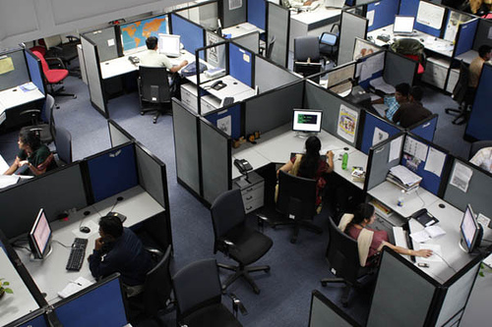
Departmentation

Slide 3

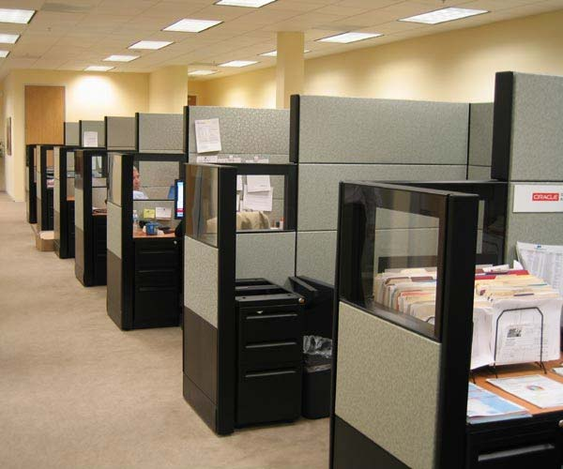
Patterns of departmentation
Departmentation by Simple numbers
Departmentation by Time
Departmentation by Enterprise functions
Departmentation by Territory/Geography
Departmentation by Product
Process/Equipment Departmentation
Customer Departmentation
Matrix Departmentation

Slide 4

Departmentation by numbers
This is structural departmentation include – grouping all persons who are to perform the same duties and functions and putting them together under the supervision of a manager.
Age old method and rapidly falling into disuse

Slide 5
Departmentation by numbers
Reasons for the decline:
The technology is advancing very fast, demanding more specialized and different skills.
Groups composed of specialized personnel are more frequently more efficient than merely based on numbers.
It is useful only at the lowest level of the organization structure.

Slide 6

Departmentation by time
Suitable for lower level of the organization
Oldest form structuring organization
Grouping of activities according to basis of time
The use of shifts is common in many enterprise because normal workloads become insufficient and ineffective
E.g.: Hospital, Production facilities

Slide 7

Advantages
Services offered 24X7 instead of 8 hrs shift
Process need not be interrupted which needs a continuous cycle of operation
Expensive capital equipment can be used more than 8hrs/day
Students attending classes during the day’s time can work in night shift to sustain their living.

Slide 8
Limitations
Supervising during night shift becomes difficult
There is fatigue factor, since it is difficult for most employees to change their biological clock
Having several shifts may cause problems with coordination and communication
Payment of overtime can increase the cost of production or services rendered.

Slide 9
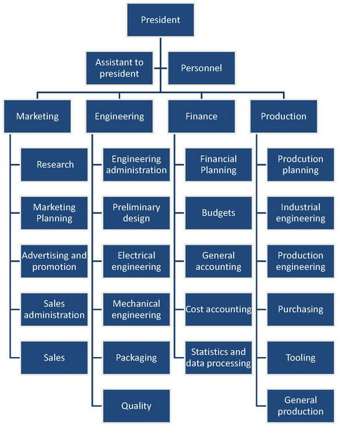
Functional departmentation
The most widely used form of departmentation
Groups activities by function—the jobs to be done.
Consistent with the idea of specialization and division of work, activities that are alike or similar are placed together in one department and under a single chain of command.

Slide 10
Functional departmentation
Functional departmentation also facilitates coordination since a supervisor is in charge of one major area of activity.
It is easier to achieve coordination this way than to have the same functions performed in different departments under different supervisors.

Slide 11
Functional departmentation
Strengths | Weakness
Allows economies of scale within functional departments Enables in-depth knowledge and skill development Enables organization to accomplish functional goals Is best with only one or a few products | Slow response time to environmental changes May cause decisions to pile on top, hierarchy overload Leads to poor horizontal coordination among departments Results in less innovation Involves restricted view of organizational goals

Slide 12
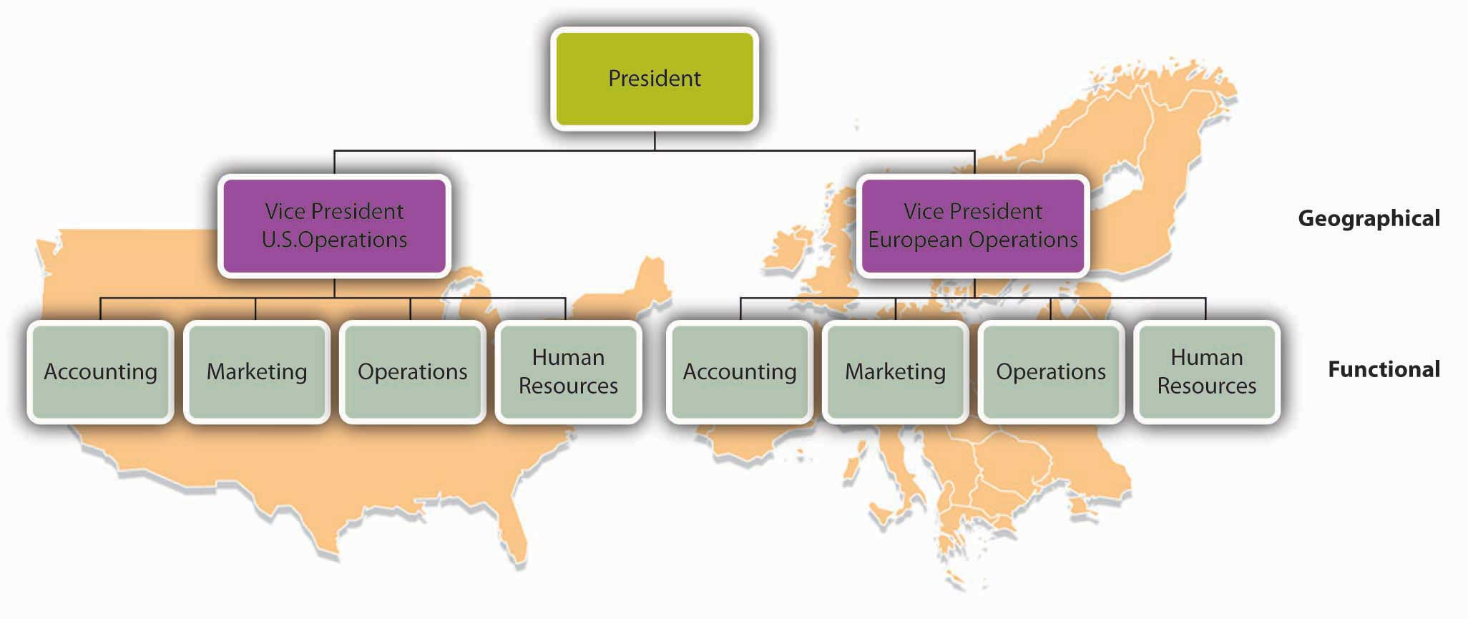
Geographical departmentation

Slide 13
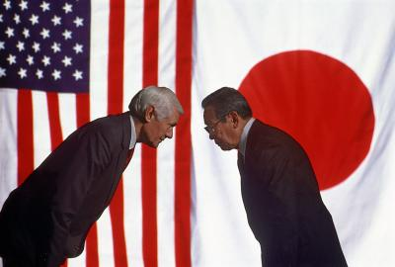
Geographical departmentation
Grouping activities on the basis of territory. If an organization's customers are geographically dispersed, it can group jobs based on geography.
For example, Coca-Cola has reflected the company’s operation in two broad geographic areas – the North American sector and the international sector, which includes the Pacific Rim, Europe, Africa and Latin America groups.

Slide 14
Geographical departmentation
Advantages | Limitations
Places responsibility at the lower levels. Places emphasis on local markets & local problems. Improves co-ordination in a region. Takes advantages of economies of local operation. Better face to face communication with local interests. Furnishes measurable training ground for general managers. | Requires more persons with G.M abilities. Tends to make maintenance of economic central services difficult. Increases problem of top management control.

Slide 15
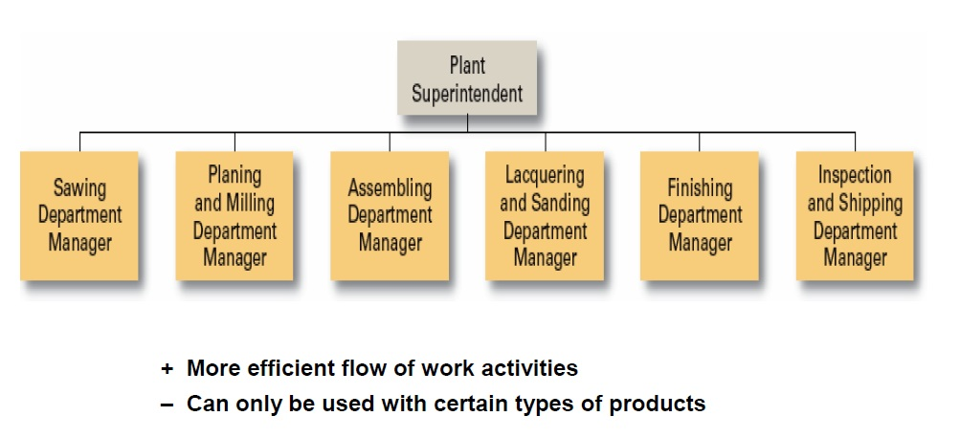
Departmentation by process/ equipment

Slide 16
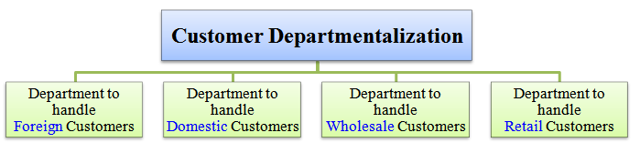
Departmentation by customer
Customer departmentalization - Grouping activities on the basis of common customers or types of customers.
The assumption is that customers in each department have a common set of problems and needs that can best be met by specialists.

Slide 17
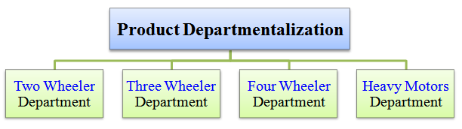
Product/ Service departmentation
E.g.: A food product company may choose to divide its operations into a frozen food department, a dairy products department, a produce department, and the like.
Product departmentation can also be a useful guide for grouping activities in service businesses.

Slide 18
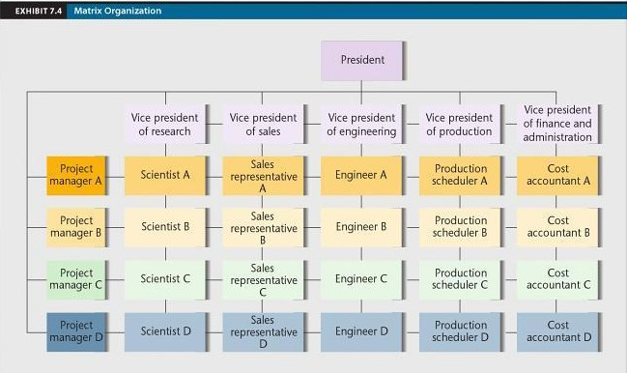
Matrix structure departmentation

Slide 19

Matrix structure departmentation
A matrix structure is a type of departmentalization that superimposes a horizontal set of divisional reporting relationships onto a hierarchical functional structure.
The essence of a matrix organization is the combination of functional and product or project patterns of Departmentation in the same organization structure.

Slide 20
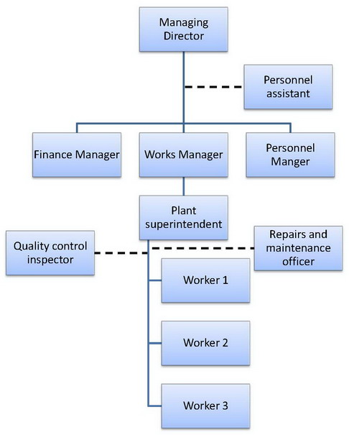
Line organization
It is the oldest type of organization. This is known by different names, i.e, military, vertical, scalar departmental organization.
The persons having greater decision making authority are placed at the top and those having the least decision –making authority are at the bottom. In between there are other levels of management such as intermediate or supervisory.

Slide 21
Line & Staff organization
A line and staff organization is one where specialist advisers, in the form of functional managers, assist the line managers in the performance of their responsibilities.
Line executives have direct control over the sub-ordinates under them. Staff executives have no such authority. Rather, they are meant to aid and advise the line managers at the same level.
Line and staff functions frequently overlap. Most staff executives may also simultaneously be line and functional executives.

Slide 22
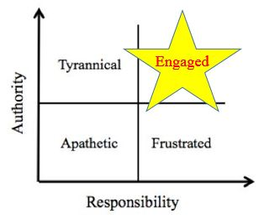
Authority
Authority: right to give orders.
“Rightful legal power to request subordinates to do certain thing or to retain from doing so, and if he doesn’t follow these instructions the manager is in a position, if need be, to take disciplinary action, even to discharge the subordinate.”

Slide 23
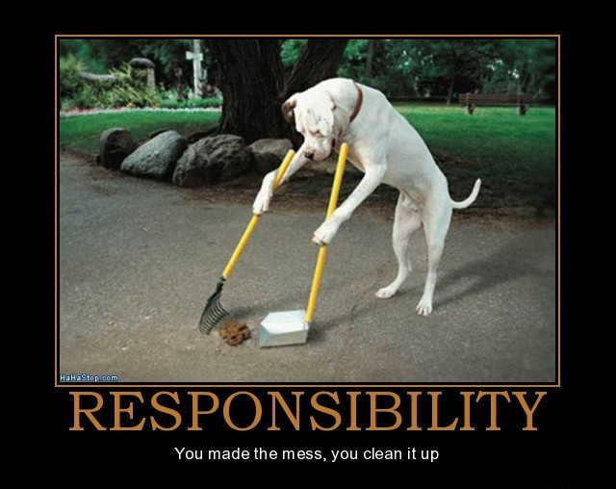
Responsibility
Responsibility: Duty or responsibility is used in many senses. It means obligation, liability, or activity or accountability.
“It may be defined as the obligation of a subordinate, to whom a supervisor has assigned a task, to perform the service required.”

Slide 24

Delegation of Authority
Delegation: “The entire process of delegation involves the determination of results expected, the assignment of tasks, the delegation of authority for accomplishment of these tasks.”

Slide 25
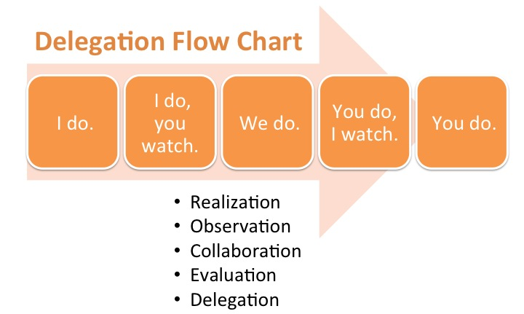
Delegation of Authority

Slide 26
Principles of Delegation
Delegation to go by results expected: Before assigning duties and delegating the authority to his subordinates, the manager should be clear in his mind as to what he expects from them.
Responsibility is absolute: A manager can delegate only authority not responsibility. Responsibility is never delegated.
Select appropriate sub ordinate for delegation:
Authority to match responsibility and vice versa: Just as an ill-equipped soldier can’t fight a battle successfully, similarly an inadequate unauthorized subordinate can’t succeed in accomplishing the assigned task.

Slide 27










Process of Delegation
Creating the obligation for the subordinate to perform the duties assigned
The delegation of authority for accomplishing these tasks
The assignment of tasks to persons in a position
The determination of results expected from persons in a position

Slide 28
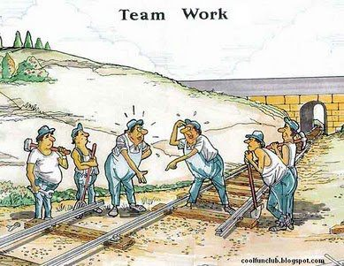
Any Questions ???

